Slide 1

COMP 560 Final Project
League of Legends
Rank Predictor
Al Pagar, Kaw Bu, Jennifer Lee, Saaketh Akula, Navya Katraju

Slide 2
Data Exploration
Used Kaggle match-level League of Legends dataset with ~100k entries
Cleaned data to include only classic game modes, fixing role labels, dropping invalid champions, and standardizing feature formats
Engineered key performance metrics: KDA, GoldPerMin, CSPerMin, DmgPerMin, VisionPerMin, DmgPerGold, and DmgEfficiency.
Identified moderate to strong positive correlations between several performance metrics and match victories, as well as strong negative correlations between deaths and winning
Noted significant rank imbalance, with Master overrepresented.

Slide 3
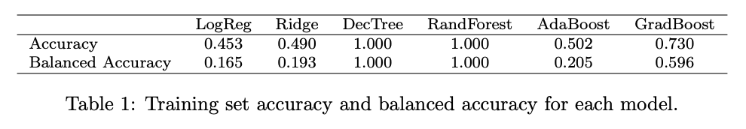
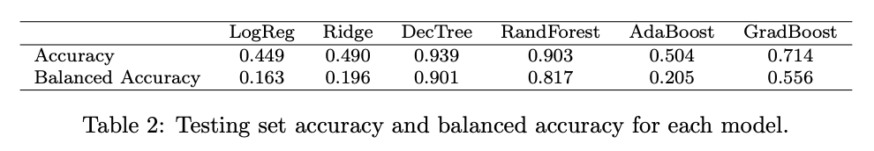
Model Evaluation
Multiple models trained on dataset: including vanilla Logistic Regression, Ridge Classifier CV, and several tree-based methods
Decision Tree achieved the strongest results with a training accuracy of 100% and a testing accuracy of 93.9%
  Able to capture non-linear relationships between features and effectively distinguish between ranks

Slide 4
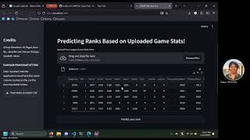
Streamlit Application Demo

Slide 5
Thank you!

